Slide 1
Aras Academic Program
October 2019

Slide 2
Program Description
The Aras Academic Program is a program that makes Aras Innovator available to educators and students. The primary goal of the program is to provide subscriber licenses of Aras Innovator to educational institutions so that educators and students can advance their PLM education. Aras provides to institutions, at no charge, access to Aras Innovator, Aras Applications, Aras Community, Customer Support, Aras Training and access to the subscriber portal. Members of the Academic Program must work directly there the supplier of their partner applications such as CAD or PLM connectors. Upgrades of Aras Innovator are not included. Aras Innovator must be used for nonprofit, educational purposes.

Slide 3
Training Options
Aras Innovator In-Center Training – Free to all students and educators https://www.aras.com/en/training/training-classes
PLM Essentials - 3 day Introduction to Product Engineering and Program Management
Aras Innovator Configuring Solutions - 5 day Introduction to Aras Innovator enterprise application framework
Aras Innovator Developing Solutions - 3 day custom programming and integration with the Aras Innovator enterprise application framework and solutions
Access to In-Center Training Documentation - The link to the FTP site and login credentials for Academic Subscriber-only FTP site will automatically be emailed to the “support” contacts upon registration
Online Learning Courses (Go to Subscriber portal / Training Resources for links)
Component Engineering
Manufacturing Process Planning
Quality Planning Essentials
Product Engineering Essentials
Program Management Essentials
Visual Collaboration
Self Service Reporting
Technical Documentation
Tech Tips (Go to Subscriber portal / Training Resources for links)
Technical tips to help you with specific issues
Training Locations
Andover, MA
Troy, MI
Munich, Germany
Tokyo, Japan

Slide 4
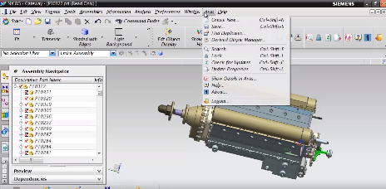
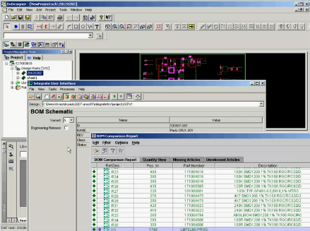
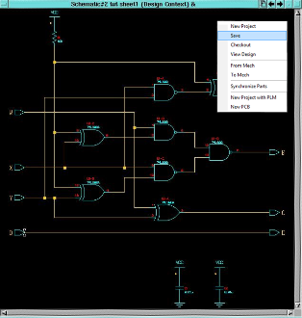
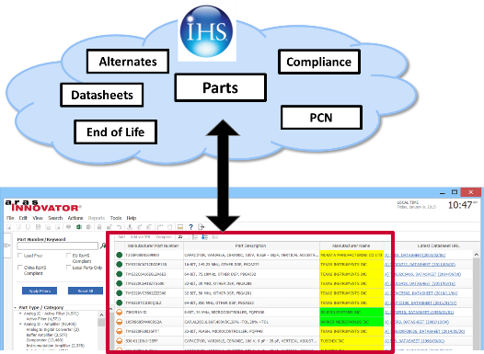
Add-on Solutions (Must be purchased separately)
Aras Offers Solutions with Popular MCAD and ECAD Solutions
Mechanical CAD Connectors
CATIA, Siemens NX
Creo Parametric
SolidWorks, Solid Edge
Inventor, AutoCAD
ECAD/EDA Connectors
Electronic Circuit Board - Schematic Design
Electronic Circuit Board - PCB Layout Design
Electrical Wire / Cable Harness
Licensing – Concurrent user
Component Engineering with IHS
Access to IHS Component Information – directly from Aras Innovator Parts
Part datasheets, Environmental compliance information
Mfr Alerts: PCNs, EOLs, counterfeit alerts, Component life cycle information
Licensing – Subscription Users or # of Parts
ERP Integrations
ERP Connectors
SAP
Oracle
Others
Licensing - Number of Subscription Users
NX
DX Designer
Schematics
Component Engineering

Slide 5
CAD Connectors
The following CAD connectors are available for Aras Innovator. These connectors are provided by partners of Aras and not part of the free subscriber license. You can purchase the connector from Aras at list price or you can reach out to the partner ask about their academic discount.

Slide 6
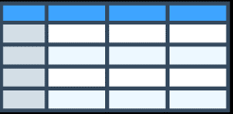
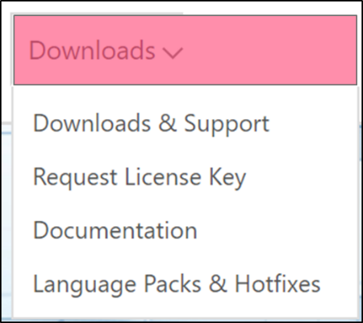
Productivity and Support
Productivity tools and Utilities
Data Import (batch load) Tools
Replicated Vaulting Capabilities and Vault Restore Utilities
Subscriber portal – documentation and knowledgebase
Access to Aras Innovator All Service Pack Updates
3-4 Service Packs/Year
Hot fixes and security patches
Aras Innovator Support
Experienced Aras support engineers provide live hotline and online support
5 Days/week x 10 Hrs day
7 Days/week x 24 Hrs day – for 1,000+ user subscriptions
Developer support and escalation management
Performance tuning and analysis
Status Support Incidents via the Subscriber portal
Batch Upload
Support@aras.com

Slide 7
Academic Program Benefits
 |  | Open-Access | Academic Subscription | Comments
Applications | Product Engineering | Yes | Yes
 | Program Management | Yes | Yes
 | Process Quality Binding | Yes | Yes
 | Manufacturing Process Planning | Except features noted | Yes | The work instructions publishing feature (HTML, PDF)
 | Technical Documentation | Except features noted | Yes | The publishing feature (XML, HTML, PDF)
 | Quality Management System | Except features noted | Yes | The export feature (Excel, XPS)
 | Component Engineering | Level 1 only | Level 3 | Access to Level 3 data and features (see Appendix) requires a Component Engineering subscription (separate from Aras Innovator subscription)
 | Requirements Management /ENGINEERING | No | Yes | All - RM has been EOL. RE is a new / separate product.
 | Aras Impresa MRO | No | Yes | All
 | Aras Comet SPDM | No | No

Slide 8
Academic Program Benefits
 |  | Open-Access | Academic Subscription | Comments
Partner Connectors | CAD Connectors (from Partners) | No | Yes | University may purchase connector from Aras or may reach out to vendor and request a University Discount
 | Solidworks | No | Yes
 | Creo | No | Yes
 | NX | No | Yes
 | Catis | No | Yes
 | Inventor | No | Yes
 | AutoCAD | No | Yes
 | SolidEdge | No | Yes
 | All ECAD | No | Yes
 | Digital Mockup (from Kisters) | No | Yes | All (requires partner connector subscription in addition to Aras Innovator subscription)
 | ASFALIS Multi-CAD Gateway (from Elysium) | No | Yes | All. Requires partner subscription in addition to Aras Innovator subscription
 | Enterprise Integrations (from Partners) | No | Yes | All (requires partner connector subscription in addition to Aras Innovator subscription)

Slide 9
Academic Program Benefits
a
Aras Connectors | Office Connector | No | Yes | All
 | Altium Vault Connector | No | Yes | All
 | Solidworks EPDM Pro Connector | No | Yes | All
Other | Support | No | Yes | Access to customer support (Telephone, On Line …) for designated people
 | Training | No | Yes | Free attendence at Aras ILT sessions, Access to On Line Training, Access to PDF's of ILT training manual upon request
 | Community | No | Yes | Access to Community.Aras.Com Blogs, Forum, Aras and Community Projects
 | Upgrade Services | No | No
 | Access to Aras Logo and Branding Guidelines | No | Yes
 | Access to service packs | No | Yes
 | Access to the Aras Subscriber Portal | No | Yes
 | Aras Community | Yes | Yes

Slide 10
Academic Program Benefits
Features | 3D CAD to PDF Converter | No | Yes | All
 | Visual Collaboration | No | Yes | All
 | Replicated Vault | No | Yes | All
 | Self-Service Reporting | No | Yes | All
 | Enterprise Search | No | Yes | All
 | Single Sign-On | No | Yes | All
 | All other capabilities | Yes | Yes | All

Slide 11
Support Options Summary
Support Type | How to Access
Telephone Support | To access a support person by telephone Monday – Friday, 8am to 6pm ET, please call +1 (978) 691-8900 and select option 2.
On Line Support | To access online support during the same timeframe, please email us at support@aras.com.
Knowledge Base | You can also find the forums, blogs, a knowledgebase and the support matrix at https://www.aras.com/SubscriberPortal/support.aspx
Product Documentation | https://www.aras.com/support/documentation/
Open Community Forum | Aras Open PLM Community you will have access to Blogs, Discussions, the Aras Knowledge Base, Community Projects and Aras Labs.
General Partner Program Questions | Partners@Aras.com
Training | https://www.aras.com/university/training-classes.aspx
Program Announcements | Partner Portal https://community.aras.com/partner-portal/b/announcements
Downloads | Partner Portal: Office Connector: https://community.aras.com/subscriber-portal/p/downloads
Demo Environments | Partner Portal https://community.aras.com/partner-portal/p/downloads
View and Log Your Subscribers Issues & Incidents | Partner Portal https://community.aras.com/partner-portal/p/support
Product Roadmap | Partner Portal https://www.aras.com/plm-roadmap/

Slide 12
Upgrade Options
Upgrades Educational Institutions have several options when it comes to upgrades
Stay on the existing version If the institution is active in the program and an active subscriber, Aras will continue to offer support
Keep projects short When the project is complete, down load the latest version and begin the next project
Save and document all your configurations and customizations. Backup your institutions data. The Aras architecture is comprised of four layers: Client, Application, Services and Repository. The repository layer is where the application models and vaulted files are stored, which can be packaged and moved at any time. If a newer version is download, you can reconnect connect to the repository but you will need to rewrite the configurations and customizations
Pay Aras for Upgrade Services In special situations Aras may be contacted to updated a university. Depending on the scope the fee maybe between $10,000 and $15,000.
Upgrade Tools Aras has created several tools to help prepare for upgrade. These documents can be found in the Upgrades tab of the subscriber portal. They include:
Upgrade Planning Enhancements Video
Why Upgrade Presentation - Why upgrade and how to get there
Upgrade Introduction - Upgrade services should you decide to purchase an upgrade
Upgrade Test Planning Guide – Step-by-step instructions on developing an overall test plan
Test Case Template – Sample Tests for Part Management Functionalities
Upgrade Practices Example – Upgrade case study with Lord Corporation

Slide 13
PLM Instruction Options
Essentials of PDM – Enabling the Digital Enterprise is a textbook by professors Amy Mueller, Jorge D. Camba and Travis Fuerst from the Department of Computer Graphics Technology at Purdue University. The goal of this book is to provide a resource for educators to expose students to the basic concepts, capabilities and processes associated with PDM so that they are familiar with the tools and methods they will encounter in their future careers. The book provides a solid foundation of product data management in clear, understandable language without vendor bias or hype. The book is available from the publisher’s website: www.EssentialsOfPDM.com.
Product Lifecycle Management: 21st Century Paradigm for Product Realization John Stark is a leading expert, consultant and writer at the forefront of Product Lifecycle Management (PLM), the business activity of managing products across their lifecycles - from innovation, through definition, realization and support to retirement. Stark's books propose concepts and approaches with which companies can address and improve their PLM performance. He draws on widespread experience gained working with more than a hundred companies in a range of industry sectors. His first book was published in 1986, his most recent in 2019. The book is available on Amazon: https://www.amazon.com/exec/obidos/ASIN/3319174398/engineeringdatam
Purdue University PLM Certificate Program The Purdue PLM Certificate Program combines concepts with experiential learning to maximize a practical, “real world” focus on Product Lifecycle Management (PLM). https://polytechnic.purdue.edu/digital-enterprise-center/plm-certificate-program

Slide 14
PLM Instruction Options
CIMdata – PLM Certificate Program CIMdata’s Public PLM Certificate Program leverages CIMdata’s internationally recognized 5-day PLM Certificate Program for Industrial Organizations and PLM Solution Suppliers. https://www.cimdata.com/en/events/cimdata-plm-certificate-program
Professional PLM Initiative There is a Professional PLM Initiative whose goal is to establish a professional structure within the PLM industry that will support its practitioners, and the discipline of PLM itself, into the long-term future. Details can be found here http://www.professionalplm.org/
IpX CM2 Certification IpX’s education sector is the premier worldwide industrial resource for configuration management, systems engineering, operational excellence, digital transformation and high-performance culture training with courses offered in seven languages. IpX is best known for the creation of the industry changing CM2 certification program initiated in 1986. https://ipxhq.com/training/cm2-courses/about-cm2-certification-courses

Slide 15
Aras Academic Institutions
Academic institutions around the world are using Aras in the classroom, and providing future business and technology leaders with advanced training in one of today's hottest areas: innovation.
Australia
Colombia
Finland
France
Germany
India
Italy
Japan
Mexico
Netherlands
Pakistan
Poland
Romania
South Africa
South Korea
Spain
Sweden
Switzerland
United States
50+ Institutions in the program
https://www.aras.com/academic-program

